Slide 1


“Error detection and correction for substitution error “
Made by
Yasmina Hussein Ahmed Taha
Heba Abdelhamid AbdelAzim Abdelhamid
Salma Mohamed Abdelqawi
Prof. Dr. Teaching assistant:
Sara El-Metwally Eng/ Leqaa Hani

Slide 2
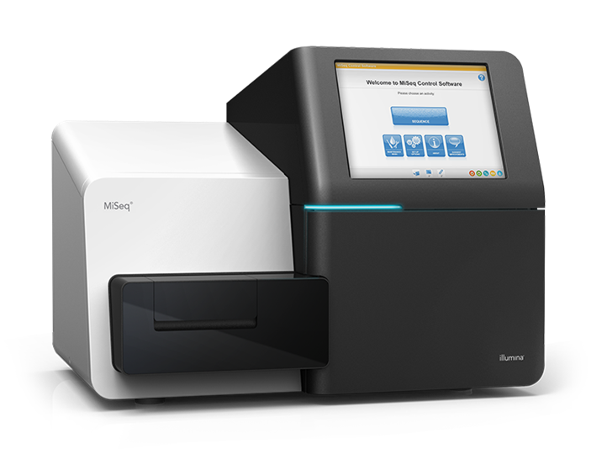
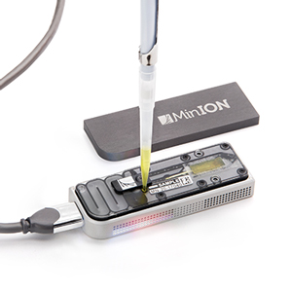
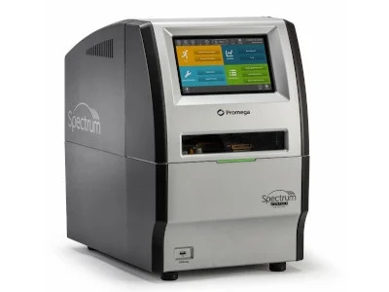
Introduction:
All the sequencing machines seek to give accurate sequencing reads ,but it has some difficulties because each generation of them has a specific type of errors related to it .

Slide 3
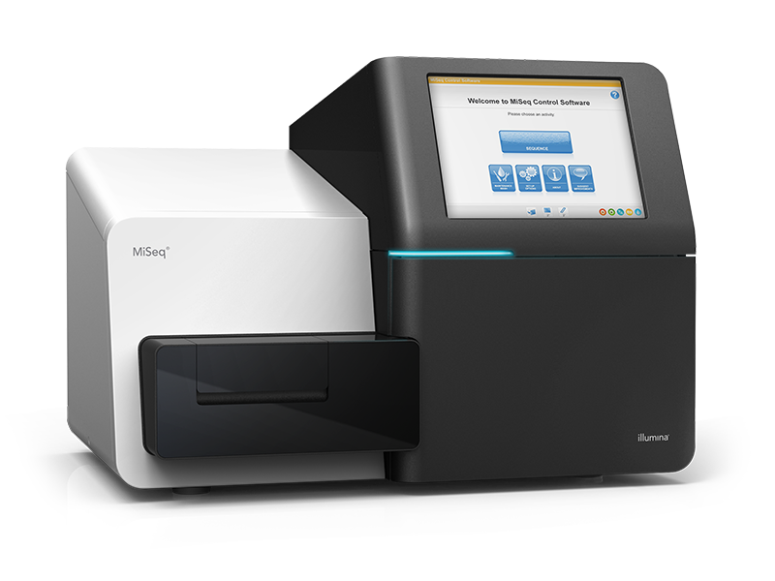
Problem:
illumina machine causes substitution errors .So it will be difficult for bioinformaticians to distinguish between these errors, the true variation and mutations.

Slide 4
Objective:
We seek to detect and correct substitution errors from sequencing data that is produced by illumina machine to make these reads trusted while analyzing these results by bioinformaticians

Slide 5
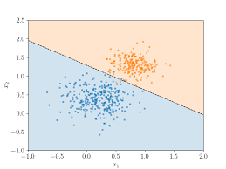
Our algorithm:
We divide the sequencing reads and reference genome into k-mers
we will put a decision boundary to distinguish the true reads from errors ones by considering the less repeating reads as errors.

Slide 6
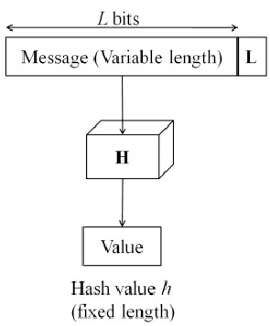
.
3- We will compare the error k-mer with mostly similar kemer to it and correct it by using hash value

Slide 7
4-Finally ,we will use the reference genome to make sure that these k-mers are actual errors not mutations or true variation by searching them in the reference. In the case of not finding them , they are substitution errors caused by illumina machine .

Slide 8
Thank you

